Slide 1


Analysis of increased patient monitoring as a predictor of blood culture results in NICU
Mila Orlovsky
Supervised by Prof. Joachim Meyer
In collaboration with Tel Aviv Medical Center (Ichilov). With Dr. Ahuva Weiss-Meilik and Dr. Alexis Mitelpunkt
December 2017

Slide 2
Background
2
Sepsis is a life–threatening condition, an immune response triggered by blood-stream infection
Neonatal Sepsis occurs during the first 4 weeks after birth (the neonatal period)
Case fatality of 26-46%, including mortality and long term morbidity, as well as neurodevelopmental complications
Singer M. et al. The Third International Consensus Definitions for Sepsis and Septic Shock (Sepsis-3). JAMA. 2016; 315(8):801-810
Dong Y, Speer CP . Late-onset neonatal sepsis: recent developments Archives of Disease in Childhood - Fetal and Neonatal Edition. 2014.
Clark, R.H et. al. Nosocomial infection in the NICU: a medical complication or unavoidable problem? 2004. Journal of perinatology 24 6, 382-8.

Slide 3
Background
3
Early Onset Sepsis – within first 72 hours of life
Late Onset Sepsis – presented after 72 hours
Dong Y, Speer CP . Late-onset neonatal sepsis: recent developments Archives of Disease in Childhood - Fetal and Neonatal Edition. (2014)

Slide 4
Motivation
Clinical signs that are mostly non-specific lead to a late diagnosis
Diagnosis is performed based on manual evaluation and physician’s personal attention
Timing is crucial: earlier diagnosis = earlier treatment
Data may assist physicians’ decision making process

Slide 5
Literature review
Sepsis occurs when chemicals released into the bloodstream to fight the infection trigger inflammatory responses throughout the body
Damages multiple organ systems, causing them to fail
Prevalence 0.6% to 14% depending on gestational age and geography
Singer M, Deutschman CS, Seymour CW, et al. The Third International Consensus Definitions for Sepsis and Septic Shock (Sepsis-3). JAMA. 2016; 315(8):801-810.
WHO, 2016

Slide 6
Literature review
Diagnosing process of (Neonatal) Sepsis:
Ma* 1. Blood culture withdrawal
2. If positive, infectious disease specialist's review
Treatment protocol starts promptly after culture withdrawal
Challenges:
◆ Clinical signs are mostly non-specific and inconclusive
◆ When symptoms appear, the infection already flared up
Paolucci M, Landini MP, Sambri V. How Can the Microbiologist Help in Diagnosing Neonatal Sepsis? International Journal of Pediatrics.;2012:120139
Guerti et al . Time to positivity of neonatal blood cultures: fast and furious?. Journal of Medical Microbiology 2011, 60, 446–453

Slide 7
Literature review
Clinical deterioration signs
Ma*◆ Abnormalities in heart rate, and other vital signs
Ma*◆ Temperature instability (>37.5 °C or <35.5 °C)
Ma*◆ Rise in leucocyte count or CRP
Ma*◆ Respiratory rate >60 per minute
Ma*◆ Movement only when stimulated/convulsions
WHO, 2016; NHS, 2012

Slide 8
Literature review
Risk factors
Ma*◆ Gestational age → Birth weight
Ma*◆ Gender
Ma*◆ Maternal race
Ma*◆ Clinical indicators i.e. lines, tubes
Sullivan BA., Fairchild KD. Predictive monitoring for sepsis and necrotizing enterocolitis to prevent shock. 2015. InSeminars in Fetal and Neonatal Medicine, 20(4): 255-261
Stoll BJ et al. Late-onset sepsis in very low birth weight neonates: A report from the National Institute of Child Health and Human Development Neonatal Research Network, The Journal of Pediatrics, 1996. 129, (1): 63-71, ISSN 0022-3476

Slide 9
9
“A decision made on the basis of scientific observations but with the added skill provided by long experience of similar cases. To this must be added an innate ability to make balanced judgments, based not only on the state of the patient and its predictable future, but also on some considerations for the patient's overall well-being, financial status and degree of psychological, or in some cases actual, dependence"
Clinical judgment.(n.d.) Miller-Keane Encyclopedia and Dictionary of Medicine, Nursing, and Allied Health, Seventh Edition. 2003.

Slide 10
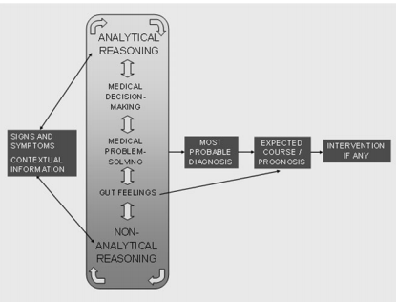
Literature review
Clinical decision making model (Stopler et al., 2011)
Stolper et al. Gut Feelings as a Third Track in General Practitioners’ Diagnostic Reasoning. GEN INTERN MED. 2011. 26: 197.

Slide 11
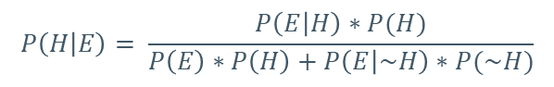
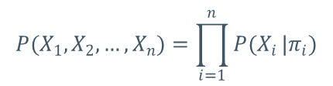
Literature review
Bayesian Network models a binary result, as a dependent on an prior evidence
*
$$P(X_{1},X_{2},…,X_{n})=\prod_{i=1}^{n}{P(X_{i}}|π_{i})$$
X_{i} – evidence i
Π_{i} – set of dependencies
$$P\left(H | E\right)= \frac{P\left(E | H\right)∗P(H)}{P\left(E\right)∗P\left(H\right)+P\left(E | \sim H\right)∗P(\sim H)}$$
H – posterior event
E - evidence
Ben-Gal I., Bayesian Networks in Ruggeri F., Faltin F. & Kenett R., Encyclopedia of Statistics in Quality & Reliability, Wiley & Sons 2007

Slide 12
Literature review
Cost Effectiveness Analysis (CEA) evaluation performed by comparing the relative expected values of different alternatives
Can provide information about how resources might be allocated in the most effective and efficient matter
In healthcare should also consider situation, clinical decision-making and clinical outcomes
Gold, MR., Siegel JE., Russell LB., Weinstein MC. Cost-effectiveness in health and medicine. 1996. Oxford university press

Slide 13
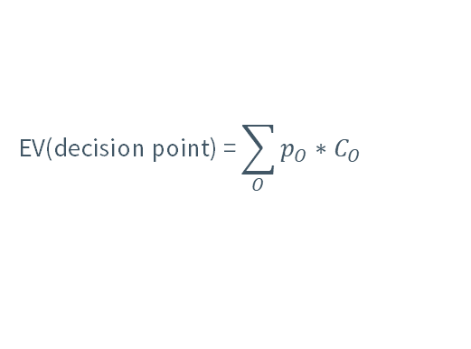
Literature review
Alternatives (choices) represent interventions
Cost are outcomes, measured in natural units i.e. lives saved, complications avoided etc.
p
C_{o1}
EV
$$\text{EV}\text{(}\text{decision} \text{point}\text{) =}\sum_{O}{p_{O}∗C_{O}}$$
1-p
C_{o2}
C₀ – Cost of specific outcome
p₀ – probability of a specific outcome
Robinson R. Cost-effectiveness analysis. 1993. BMJ;307:793

Slide 14
Research scope
Which indications influence physician’s suspect of deterioration towards Sepsis, leading to culture withdrawal?
Is heart rate monitoring decision a priori risk for positive blood culture?
Can we recommend to sample all those who are monitored for heart rate?
Target variable: Positive neonatal sepsis
Proxy indicator:
Positive blood culture

Slide 15
Methods | Data Collection and integration
SAP
IMDSOFT
Administrative record
Admission, discharge, demographics
Clinical EMR
Monitors (vital signs), events
SAP
IMDSOFT
Chameleon
SAP
Administration
AutoDB
Chameleon
AutoDB
Obstetric
Birth details, maternal data
Microbiology Labs
Culture type, time stamps and results

Slide 16
Methods | Preprocessing
Data Imputation
Ma*◆ If meaningless records – delete e.g. 2 mistake records
Ma*◆ If alternative source exists – complete e.g. gender and gestational age
a*◆ Imputation by mode in same category e.g. Apgar score
Data Cleaning
Ma*◆ 38 duplicates (0.9%) removed
Ma*◆ Exclusion criteria: mortality within 3 days from admission

Slide 17
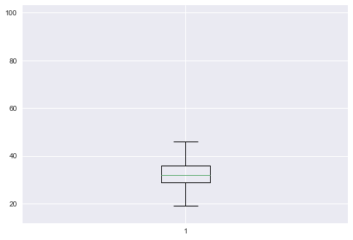
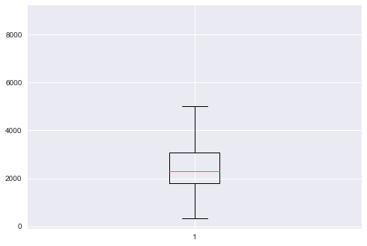
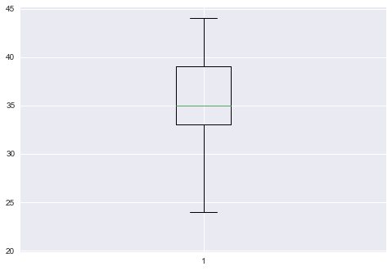
Methods | Preprocessing
Outliers
Data transformation
Ma*◆ Microbiology binary variables Culture binary, first positive culture
Ma*◆ Grouping birth weight
Ma*◆ Heart rate aggregations n, mean, std, median
Ma *◆ Calculation SGA
Maternal age
Birth weight
Gestational age
8810
99
22+43+44 weeks

Slide 18
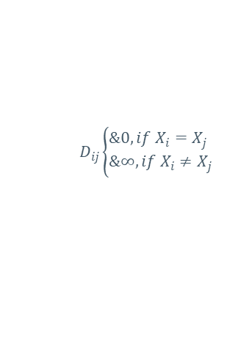
Methods | Preprocessing
Matching
Ma*◆ Coarsened Exact Matching (CEM) - comparing two individuals with the same observable Ma*◆ characteristics, one of whom was treated and the other was not
X = (X₁, X₂, ... X_{k}): a column vector of observed values of pretreatment covariates = (Apgar 5, gestational age, gender, weight group)
$$D_{ij}\left\{\begin{aligned}&0, if X_{i}=X_{j} \\ &∞, if X_{i}≠X_{j} \end{aligned}\right.$$
D_{ij} : the distance (similarity) between two items i and j where
R_{i} : rank of each variable i within a bin
For each i and j in "untreated cases"
Calculate D_{ij}
If D_{ij}= 0 then R_{ij} = R_{ij} +1
Add item j to potential match to i
If j was already used
j=j+1
Pseudo code
Iacus M., King G., Porro G. Causal Inference without balance checking: Coarsened Exact Matching. 2011

Slide 19
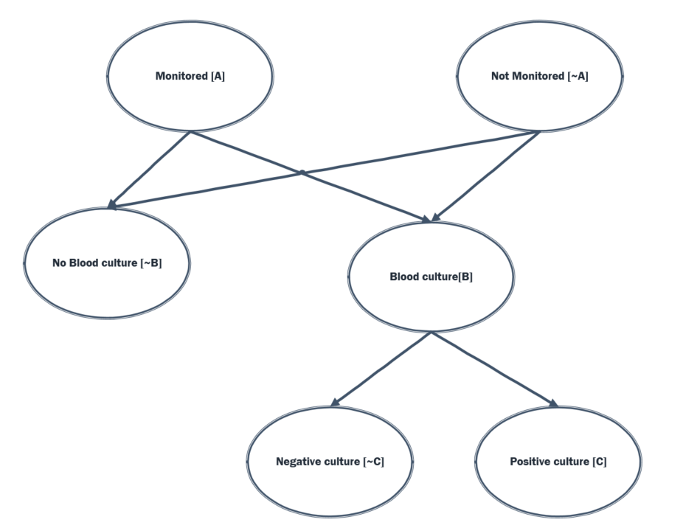
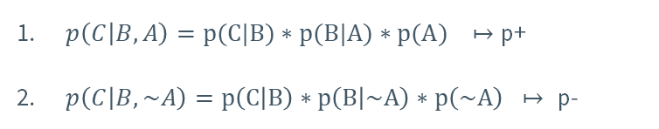
Methods | Modeling
$p\left(C | B,A\right)=p(C|B)∗p(B|A)∗p(A) ↦$p+
$p\left(C | B,\sim A\right)=p\left(C | B\right)∗p\left(B | \sim A\right)∗p\left(\sim A\right) ↦ \text{p}\text{−}$

Slide 20
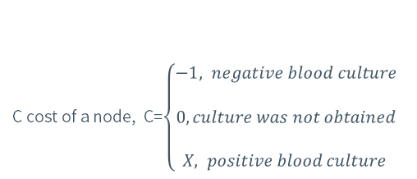
Methods | Modeling
C cost of a node, C=$\left\{\begin{aligned}−1, negative blood culture \\ \\ 0, culture was not obtained \\ \\ X, positive blood culture \end{aligned}\right.$
Note:

Slide 21
Results | Exploratory analysis
% | n
 | 4999 |  | Overall (2011-mar 2017)
54% | 2700 |  | Gender (male)
26% | 1291 |  | Twins or triplets
 | 35.5 (3.8) |  | Gestational age (mean (sd))
 | 33 | 1st Q
 | 35 | Median
 | 39 | 3rd Q
 |  |  | Apgar 1 score
18% | 897 | Poor (0-5)
35% | 1761 | Intermediate (6-8)
47% | 2326 | Normal (9-10)
 |  |  | Apgar 5 score
3% | 132 | Poor (0-5)
29% | 1443 | Intermediate (6-8)
68% | 3409 | Normal (9-10)
 |  |  | Birth type
52% | 2581 | Caesarean
39% | 1963 | Vaginal
5% | 250 | Vacuum
4% | 191 | Unknown
0.% | 14 | Breech
18% | 883 |  | Blood culture taken
9% | 81 | First positive culture
91% | 802 | First negative culture

Slide 22
Results | Exploratory analysis
Logistic regression for positive blood culture R²=0.26
 | Coef | std | z | pval
Gestational age | -0.3750 | 0.029 | -12.930 | 0.000
Gender | -0.0024 | 0.186 | -0.013 | 0.990
Apgar5 | -0.0855 | 0.064 | -1.344 | 0.017
Maternal age | -0.0231 | 0.016 | -1.429 | 0.153
Fetus Count | 0.0843 | 0.168 | 0.502 | 0.616
SGA | 0.4140 | 0.239 | 1.735 | 0.083
Birth Type | -0.0937 | 0.198 | -0.472 | 0.637

Slide 23
Results | Exploratory analysis
Culture withdrawal rate, by gestational age
p<0.05

Slide 24
Results | Exploratory analysis
Positive culture detection rate, by gestational age
p<0.05

Slide 25
Results | Exploratory analysis
First positive culture detection rate, by gestational age
NS

Slide 26
Results | Exploratory analysis
Mean (±std) of days from NICU admission to first blood culture

Slide 27
Results
Heart rate monitoring trend 12 hours before culture
P<0.05

Slide 28
Results | Exploratory analysis
Apgar 5 by gestational age distribution
High: Apgar > 8
Intermediate: 6≤ Apgar ≤8
Poor: Apgar≤ 5

Slide 29
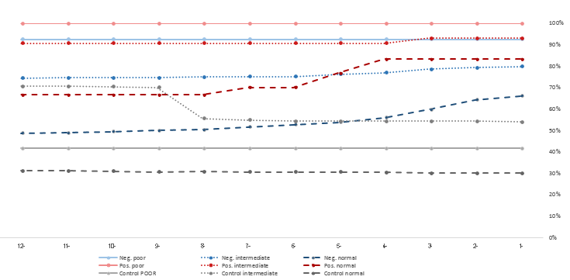
Results
Heart rate monitoring trend 12 hours before culture, by Apgar 5 score
P<0.05

Slide 30
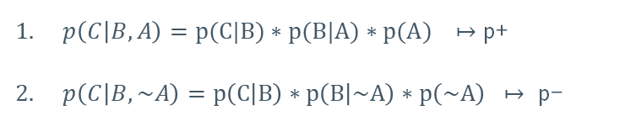
Results
Hours prior event | P(C |B,A) p+ | P(C |B,~A) p- | P value
-1 | 0.012 | 0.004 | <0.01
-2 | 0.012 | 0.004 | <0.01
-3 | 0.012 | 0.005 | <0.01
-4 | 0.011 | 0.005 | <0.01
-5 | 0.011 | 0.005 | <0.01
-6 | 0.011 | 0.005 | <0.01
-7 | 0.011 | 0.005 | <0.01
-8 | 0.011 | 0.006 | <0.01
-9 | 0.011 | 0.006 | <0.01
-10 | 0.011 | 0.006 | <0.01
-11 | 0.010 | 0.006 | <0.01
-12 | 0.010 | 0.006 | <0.01
$p\left(C | B,A\right)=p(C|B)∗p(B|A)∗p(A) ↦$p+
$p\left(C | B,\sim A\right)=p\left(C | B\right)∗p\left(B | \sim A\right)∗p\left(\sim A\right) ↦ \text{p}\text{−}$

Slide 31
Results
Apgar 5 HIGH |  |  | Apgar 5 intermediate |  |  | Apgar 5 poor
P value | P(C | B,~A) p- | P(C | B,A) p+ | P value | P(C | B,~A) p- | P(C | B,A) p+ | P value | P(C | B,~A) p- | P(C | B,A) p+ | Hours prior event
<0.01 | 0.002 | 0.006 | <0.01 | 0.048 | 0.207 | <0.01 | 0.185 | 0.284 | -1
<0.01 | 0.002 | 0.006 | <0.01 | 0.049 | 0.205 | <0.01 | 0.185 | 0.284 | -2
<0.01 | 0.002 | 0.005 | <0.01 | 0.051 | 0.203 | <0.01 | 0.185 | 0.284 | -3
<0.01 | 0.002 | 0.005 | <0.01 | 0.055 | 0.199 | <0.01 | 0.185 | 0.284 | -4
ns | 0.003 | 0.005 | <0.01 | 0.056 | 0.198 | <0.01 | 0.185 | 0.284 | -5
ns | 0.003 | 0.005 | <0.01 | 0.059 | 0.195 | <0.01 | 0.185 | 0.284 | -6
ns | 0.003 | 0.005 | <0.01 | 0.059 | 0.195 | <0.01 | 0.185 | 0.284 | -7
ns | 0.003 | 0.005 | <0.01 | 0.060 | 0.195 | <0.01 | 0.185 | 0.284 | -8
ns | 0.003 | 0.004 | <0.01 | 0.060 | 0.194 | <0.01 | 0.185 | 0.284 | -9
ns | 0.003 | 0.004 | <0.01 | 0.060 | 0.194 | <0.01 | 0.185 | 0.284 | -10
ns | 0.003 | 0.004 | <0.01 | 0.060 | 0.194 | <0.01 | 0.185 | 0.284 | -11
ns | 0.003 | 0.004 | <0.01 | 0.061 | 0.194 | <0.01 | 0.185 | 0.284 | -12

Slide 32
Results
Apgar 5 group | X cutoff
Poor | 3
Intermediate | 10
Normal | 315
Overall | 170
Apgar 5 group | X cutoff
Poor | 3
Intermediate | 10
Normal | 315
Overall | 170
X=40

Slide 33
Discussion
Decrease was found in positive blood culture detection rate, correlated with gestational age
Neonates who were found with positive blood culture, were monitored for heart rate significantly more during 12 hours prior to the culture
An increase in monitoring toward the culture event indicates there was a time gap between the decision to monitor and the decision to sample
This gap is a result of clinical judgment as part of clinical decision making

Slide 34
Discussion
The probability to detect a positive blood culture was significantly higher in monitored neonates, compared to not monitored who were sampled
Could we suggest to sample all those who are monitored?
Ma*◆ In Apgar poor and intermediate subgroups, when the physician decides to fdfggmonitor heart rate, s/he should sample promptly for blood culture
Ma*◆ In Apgar high subgroup, when a physician decides to monitor heart rate, s/he fdfggshould sample only according to specific clinical signs

Slide 35
Conclusions
Clinical practice is complex. Physicians rely on data, previous experience in similar cases and personal intuition or gut feeling
Sampling for blood culture can potentially be correlated with heart rate monitoring
Apgar 5 score could potentially be used as a stratification tool for positive blood culture
Recommendation to sample all who are monitored to increase positive blood culture withdrawal is subject to risk analysis

Slide 36
Conclusions
Preliminary research, data available for the first time
Further research has received national support, to model ALL clinical time series to determine blood sampling best policy
Cooperation of clinical expert, together with statistical and technical knowledge is essential for clinical analysis
Challenges:
Ma*◆ Data integration
Ma*◆ Data incompleteness and complexity
Ma*◆ Clinical specifications

Slide 37

Contributors
Prof. Joachim Meyer
Dr. Ahuva Weiss Meilik
Dr. Alexis Mitelpunkt
Adi Berliner and Dr. Ayala Burger
My own baby

Slide 38


Thank you
milochka.oz@gmail.com

Slide 39
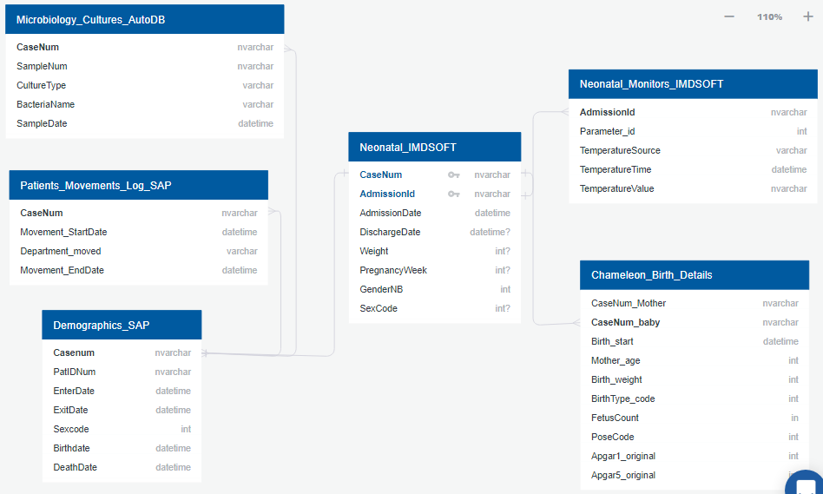
Methods | Data Collection and integration
Data Collection and integration – Database diagram

Slide 40
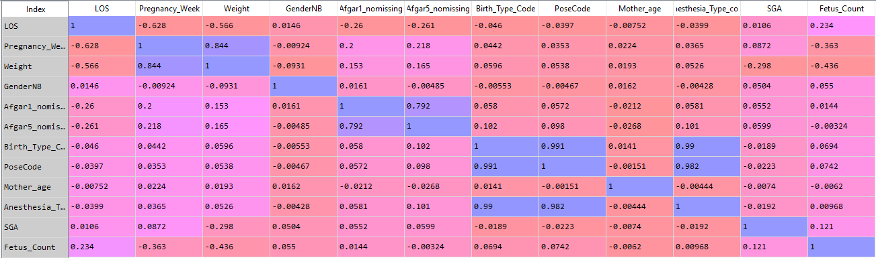
Results | Exploratory analysis
Correlation matrix (Pearson)
 | Coef | std | z | pval
Gestational age | -0.3750 | 0.029 | -12.930 | 0.000
Gender | -0.0024 | 0.186 | -0.013 | 0.990
Apgar5 | -0.0855 | 0.064 | -1.344 | 0.017
Maternal age | -0.0231 | 0.016 | -1.429 | 0.153
Fetus Count | 0.0843 | 0.168 | 0.502 | 0.616
SGA | 0.4140 | 0.239 | 1.735 | 0.083
Birth Type | -0.0937 | 0.198 | -0.472 | 0.637

